Slide 1


Wearables: Overview
JSM 2019

Slide 2
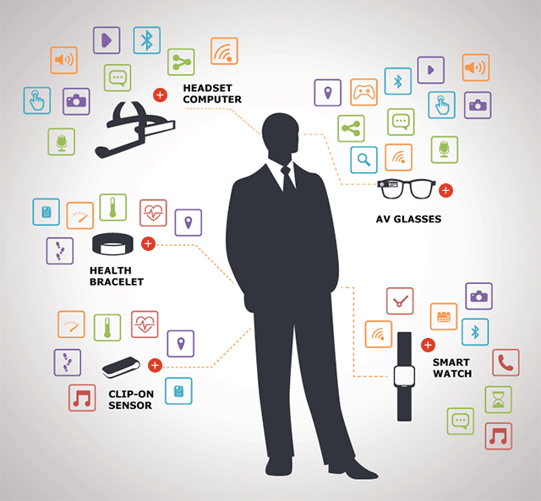
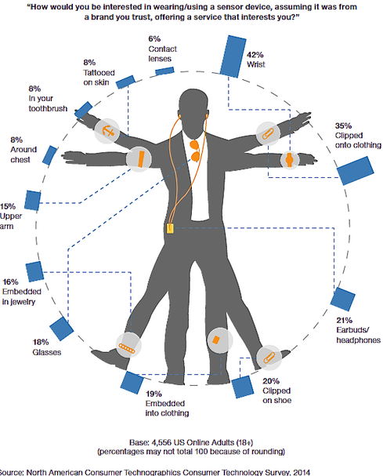
Wearables

Slide 3
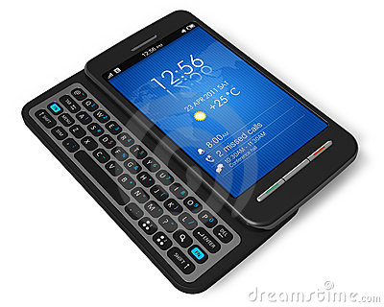
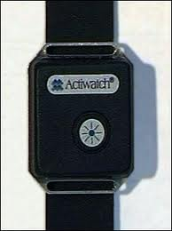
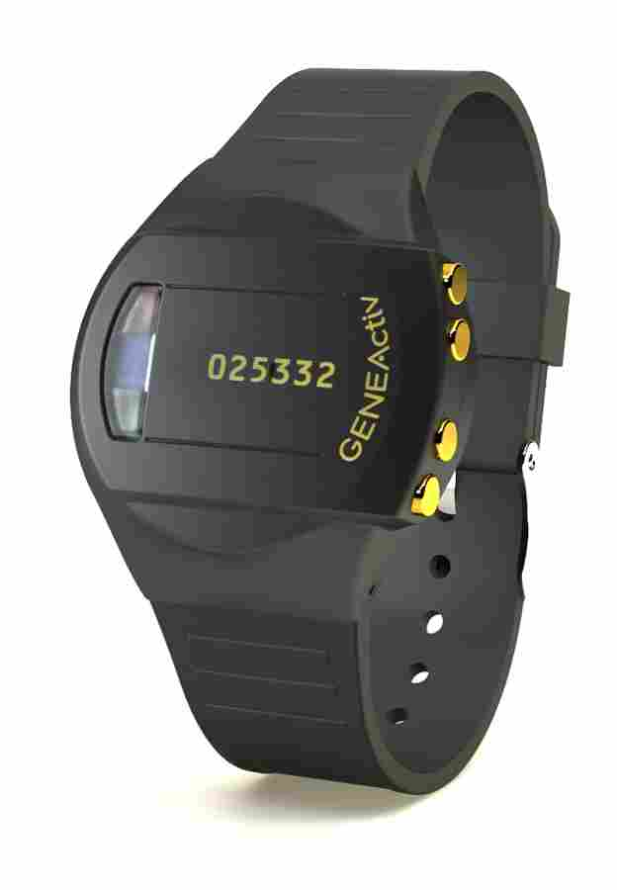
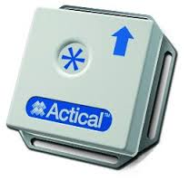
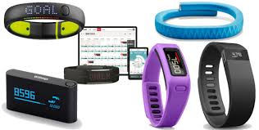
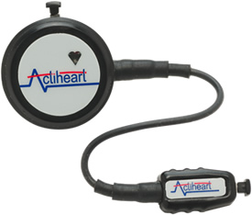
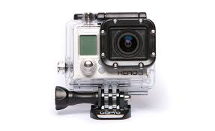
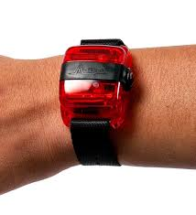
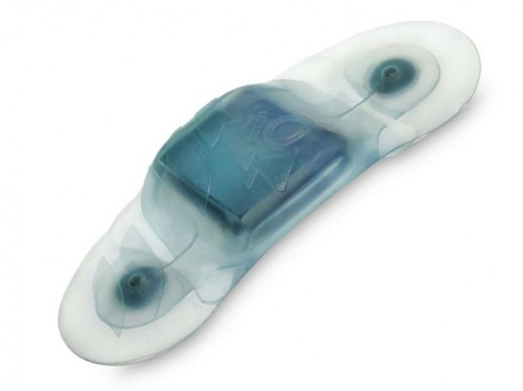
Wearables
Research
Consumer

Slide 4
What do wearables offer?
Physical Activity
Steps or Activity Counts
Steps and Gait (temporal asymmetry, stride variability)
Energy Expenditure (calories, …)
Sleep
Circadian Rhythmicity
Electronic Diary/Ecological Momentary Assessment (1-2-4 per day)
Heart Rate (ECG, bpm)
Blood Glucose Monitoring
Light, Temperature (Circardian markers)
Voice (Mood, Progression of Disease)

Slide 5
Clinical applications
Aging (BLSA, Health ABC, NHANES, UKBiobank, WHI)
Dementia and AD (Sleep & Agitation)
Cardiovascular: CHF, Afib, and post-surgery
Multiple Sclerosis (Disability & Sleep)
Mood Disorders
Cancer: Fatigue and Sleep
Diabetes (T2)
Diabetes in babies (Nurture)
Rehabilitation (METRC)

Slide 6
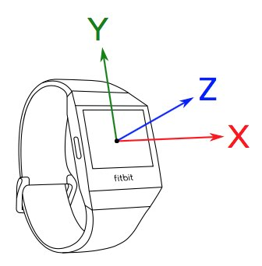
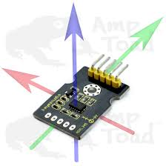
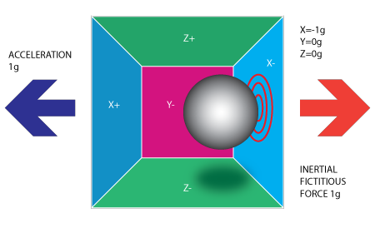
Accelerometers
Detects acceleration in three orthogonal planes
https://www.youtube.com/watch?v=irjG9Y4NGnE

Slide 8
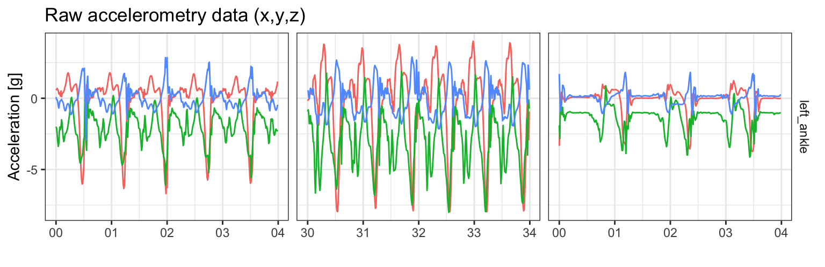
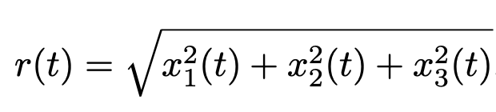
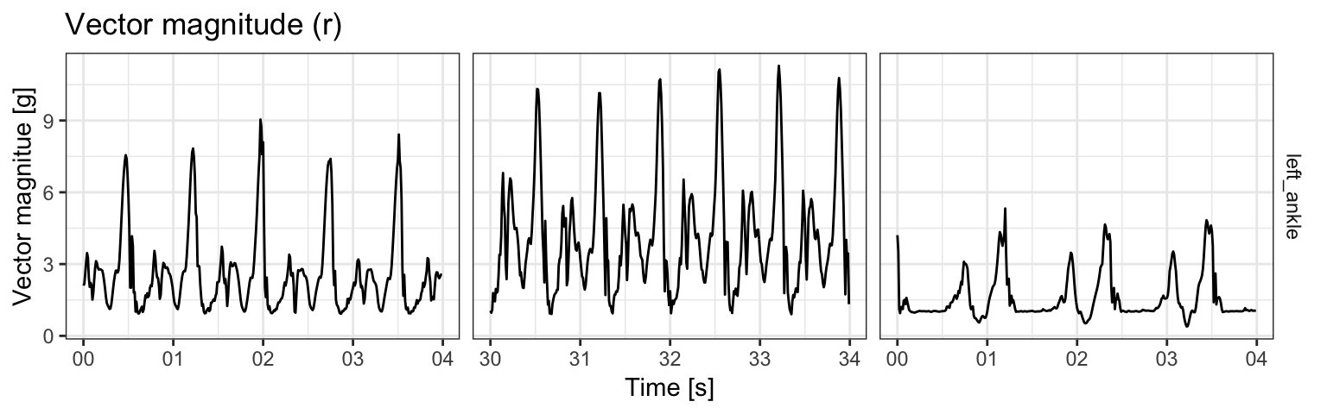
Subsecond-level accelerometry data analysis
Vector Magnitude (VM): 1-dimensional summary of 3-dimensional time-series
Running
Running fast
Walking

Slide 9
Stage 1: Episode Detection
Non-wear time
Posture: sitting, lying, standing, driving, stairs climbing, …
Activity: walking, running, driving, …
Sleep: rest/wake, in/out of bed, …

Slide 10
Stage 2: Feature extraction
Walking: cadence, stride-variability, asymmetry, …
Sleeping: time in bed, fragmentation, variability, …

Slide 11
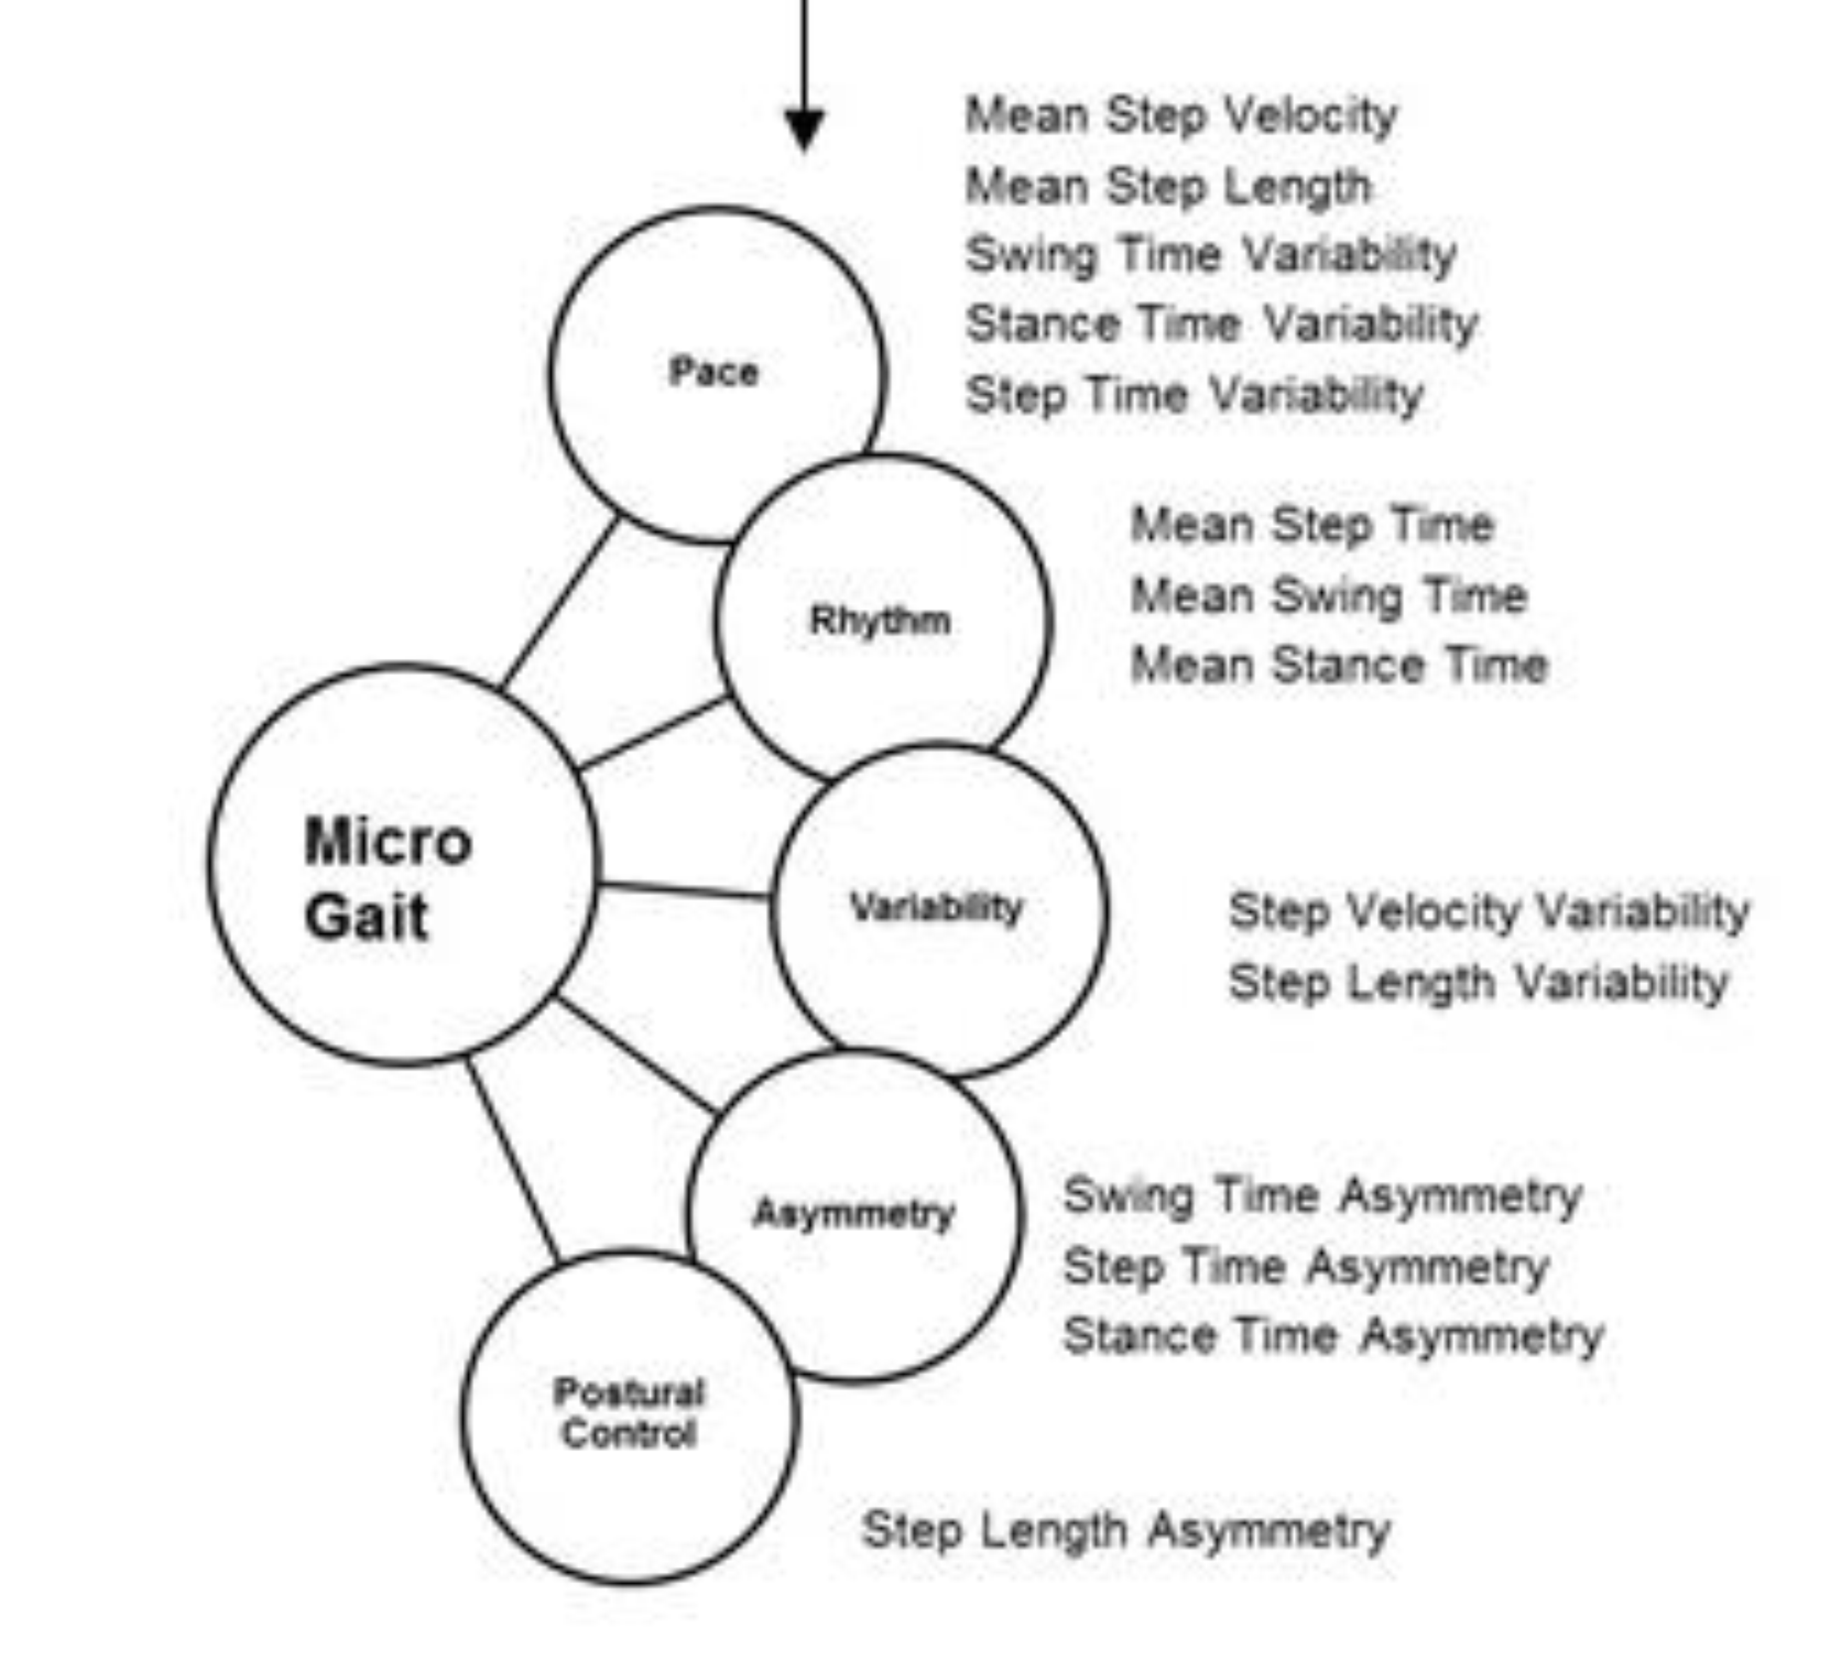
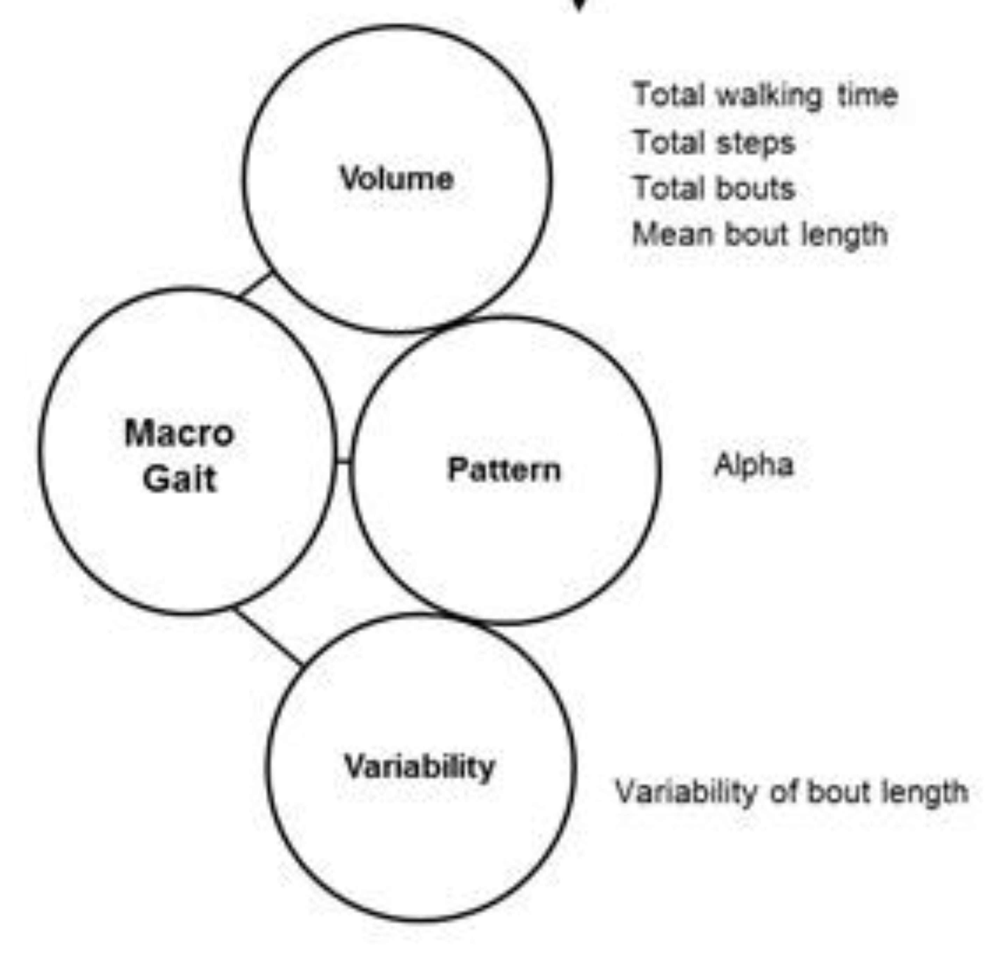
Stage 3: Feature Grouping
Example: grouping of gait characteristics
Gait in Mild Alzheimer's Disease.
Feasibility of Multi-Center Measurement
in the Clinic and Home with Body-Worn Sensors.
A Pilot Study, Zetterberg et al, 2019, JAD
Notes:
Split into two; It should fluctuate around certain zero level; show those examples in the non-event group

Slide 12
Sensor fusion

Slide 13
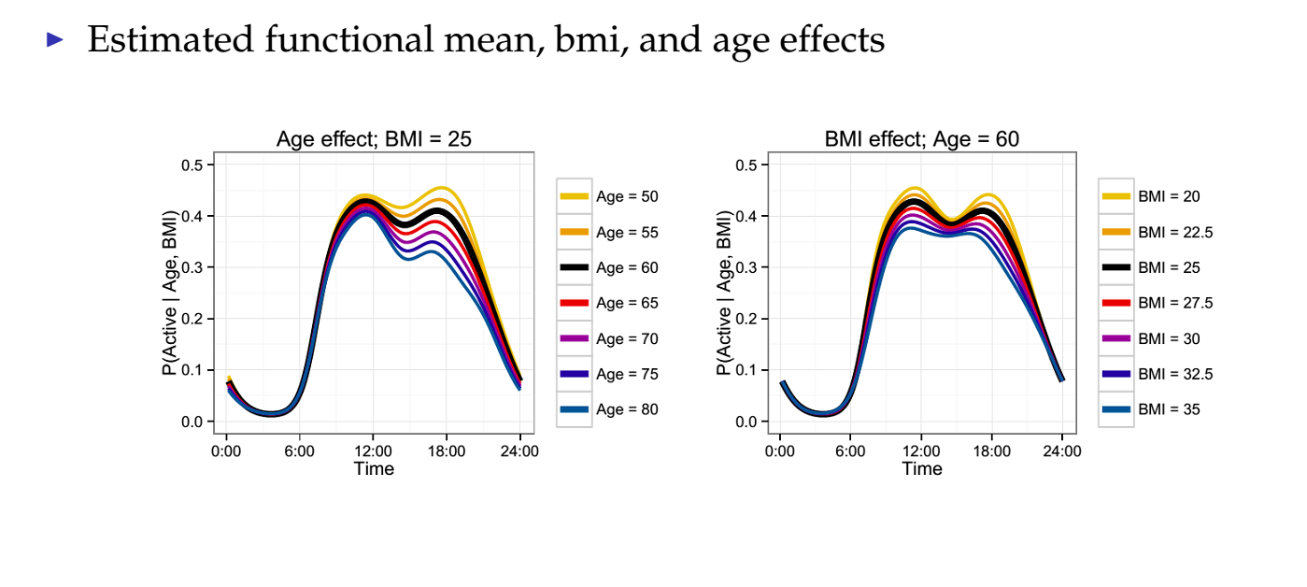
Macro-level: Diurnal Patterns
Activity Pattern = mean pattern + Age*(Age Effect) + BMI*(BMI effect) + other effects

